Slide 1
How to Make a Strong Flu Vaccine Recommendation
Serese Marotta
Chief Operating Officer
Families Fighting Flu
October 18, 2018

Slide 2

Who We Are
Notes:
National, non-profit organization in the U.S.
Mission – To save lives and reduce hospitalizations by protecting all children and their families against influenza.
Vision – That all families understand the seriousness of influenza and the importance of annual vaccination, and as a result all children and their families get vaccinated every year so that no one dies from this vaccine-preventable disease.

Slide 3

Advocates From Around the Globe
Medical Professionals & Advisors
Member Families
Staff & Volunteers
Partners

Slide 4


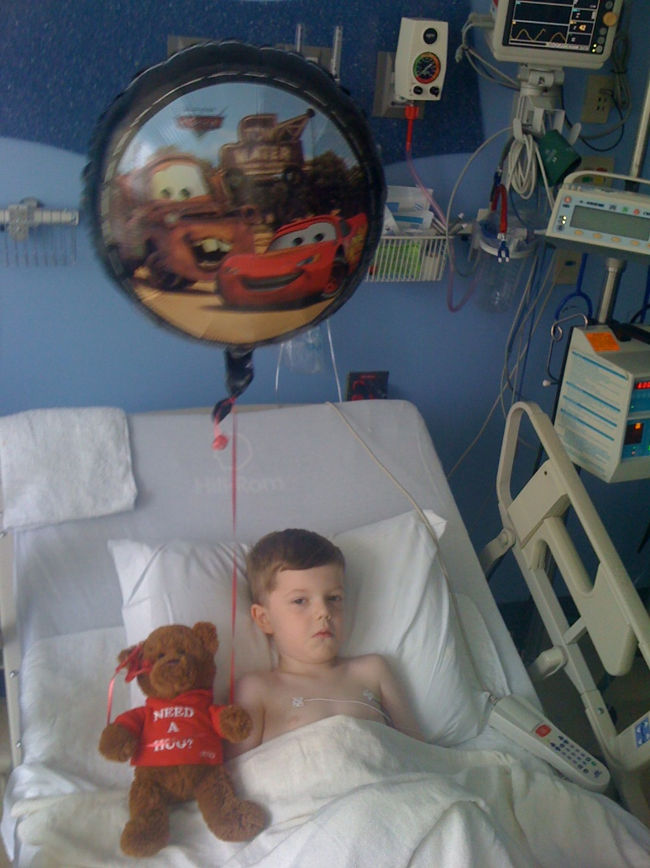
The Power of Personal Stories

Slide 5

What We Do

Slide 6













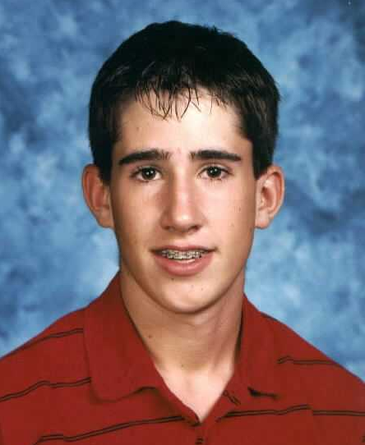


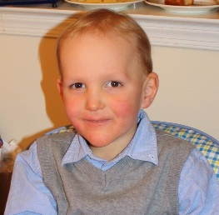
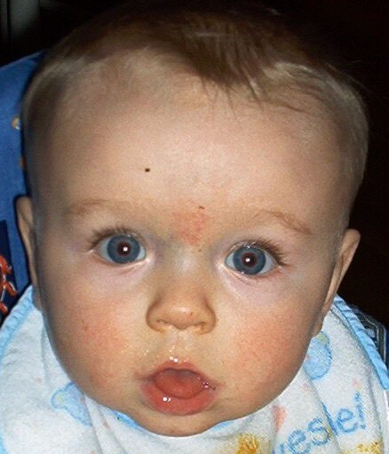

We put
a
face
on
the
flu.
Our Goal: Reduce flu-related hospitalizations and deaths
like those we witnessed with our loved ones.

Slide 7
Objectives
How to implement CDC’s SHARE method to make strong flu vaccine recommendations to patients.
How to utilize the resources in Families Fighting Flu’s Healthcare Professional (HCP) Toolkit.
How to use personal stories to communicate the dangers of flu and importance of vaccination.

Slide 8
Let’s Start with Some Facts…
2017-2018 season resulted in 80,000 deaths in the U.S.
On a global scale, kills ~650,000 people every year
Majority of the people who are hospitalized or die from flu are
NOT vaccinated
Annual flu vaccination is important for the protection of public health, not just individual health
CDC recommends flu vaccination for everyone 6 months and older
Notes:
Mention 100 yr anniversary of 1918 Spanish flu pandemic.
Mention children being vaccinated for the first time require two doses.

Slide 9
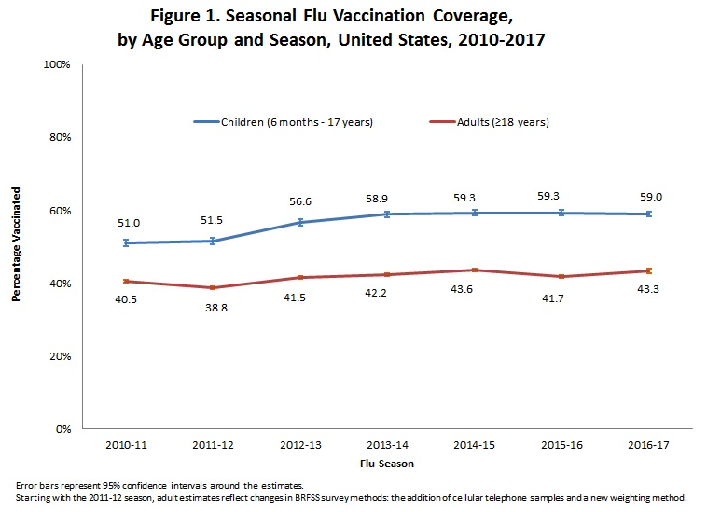
National Flu Vaccination Statistics
Source: CDC. Flu Vaccination Coverage, United States, 2016-17 Influenza Season. https://www.cdc.gov/flu/fluvaxview/coverage-1617estimates.htm

Slide 10
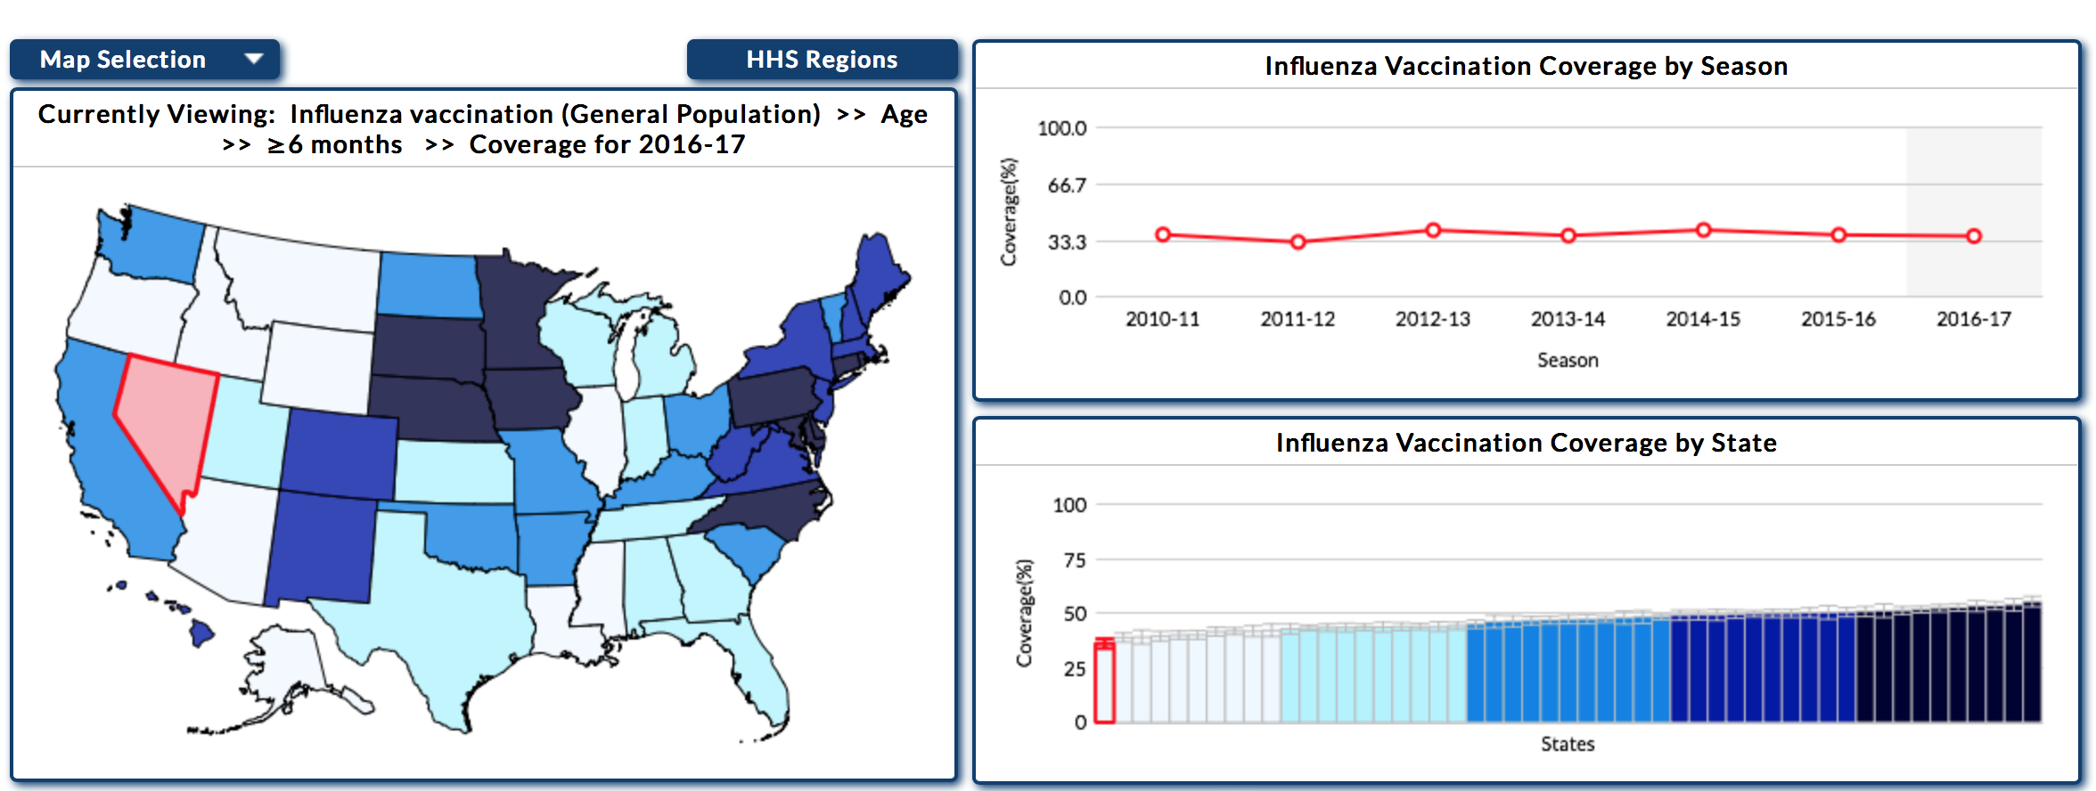
Nevada Flu Vaccination Statistics
36.1%
Source: CDC. FluVaxView.2010-11 through 2017-18 Influenza Seasons Vaccination Coverage Trend Report. https://www.cdc.gov/flu/fluvaxview/reportshtml/trends/index.html
Notes:
Rural and frontier populations in NV; access to vaccines is an issue.

Slide 11

The Role of Healthcare Professionals
Trusted resource
Educate & inform patients
Protect public health
Set the example!

Slide 12
The Critical Role of HCPs
HCP recommendation is critically important to improving flu vaccination rates!
Limiting Factors:
Patients are misinformed about flu & flu vaccination
Failure to communicate (HCPs ↔ patients)
Passive vs. presumptive vaccine recommendation
Missed opportunities for vaccination
Notes:
HCPs are trusted sources of health-related information.
Combatting myths and inaccurate information
Communication breakdown: HCPs think they’re giving a solid recommendation, but that’s not what the patients are hearing.
Presumptive approach works best.
Make every visit a vaccine visit!

Slide 13
CDC’s SHARE Approach

Slide 14
1. Share
Share the reasons why flu vaccination is the right choice for your patient
Considerations:
Other
Risk Factors
Age
Health Status
Lifestyle
Occupation
Notes:
Work in a personal story.
Age (young child, seniors are susceptible populations)
Health status (immunocompromised, cancer patient, co-morbid conditions)
Lifestyle (frequent traveler, frequent contact with others in your community)
Occupation (healthcare worker)
Other risk factors (pregnant women, obese individuals)

Slide 15
2. Highlight
Highlight positive experiences with flu vaccination (professional or private) to reinforce benefits
“I always get myself (and my family) vaccinated every year because…”
“I know flu vaccination isn’t just about protecting myself…”
“I had a patient who fell ill with influenza, but their illness was mild because they were vaccinated.”
Share scientific studies that have demonstrated how flu vaccines have been found to save lives and reduce hospitalizations.

Slide 16
2. Highlight (cont’d)
Scientific studies:
Flu vaccination was shown to reduce pediatric deaths by 65% in healthy children (Flannery et al., Pediatrics 2017)
Flu vaccination in pregnant women reduces their risk of being hospitalized from flu by 40% (Thompson et al., Clinical Infectious Diseases 2018)
Flu vaccination in pregnant women reduces newborn flu risk by 70%
(Shakib et al., AAP 2016)
Repeated flu vaccination in older adults prevents ICU hospital admissions and death by 74% and 70%, respectively (Casado et al., CMAJ 2018)

Slide 17
3. Address
Address patient questions using clear, understandable language
Why should your patient care about flu?
Potential side effects from vaccination
Vaccine safety
Vaccine effectiveness
Notes:
Work in personal stories
FFF HCP Toolkit has a conversation flowchart that can be used for patient conversations.

Slide 18
4. Remind
Remind patients why flu vaccination is so important
Helps prevent medically-attended illness
Helps reduce flu-related hospitalizations & deaths
Remind patients it’s not just about them! (Community Immunity)
Debunk myths and focus on facts (refer to CDC and/or FFF websites)
Notes:
Work in personal stories

Slide 19
5. Explain
Explain the potential costs of flu
Serious health effects
Hospitalization
Death
Long-term effects
Missed school/work
38M school days/yr
17M work days/yr
Financial costs
Medical expenses
Missed work
The CDC estimates the annual economic burden of flu in the U.S. is $87 billion!
Notes:
Work in personal stories

Slide 20
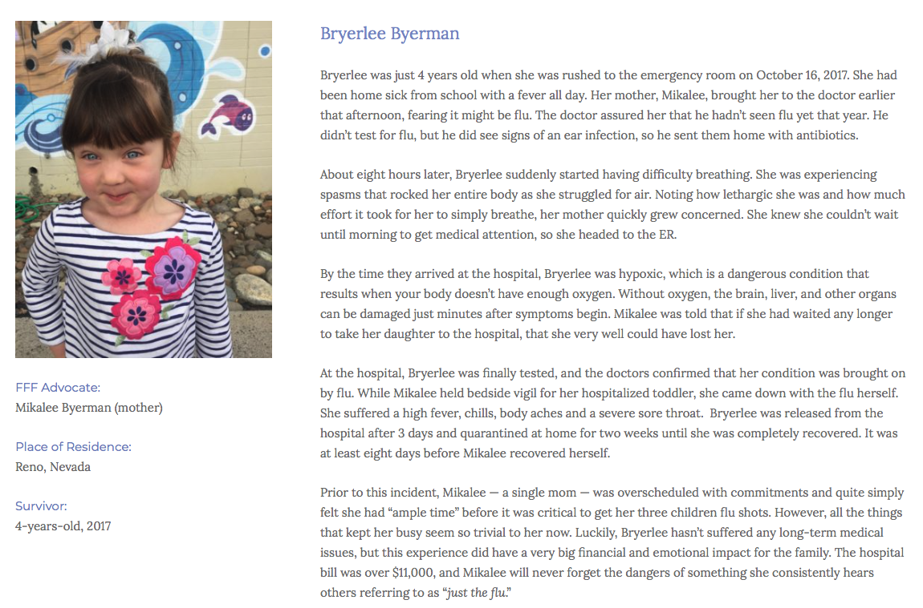
Bryerlee’s Story
Notes:
Work in personal stories

Slide 21


Families Fighting Flu’s Healthcare Professional Toolkit
Notes:
Why did FFF develop this resource?

Slide 22
HCP Toolkit Elements
Perspectives from a pediatric nurse practitioner
The devastating impact of flu: family stories
Talking points on the benefits of annual flu vaccination
Test your flu knowledge: flu quiz
Key flu-related messages to share with patients
Conversation flowchart (Q&A)
Various flu facts and statistics
Educational infographics to post in offices, exam rooms, etc.
Available for free download on the FFF website!

Slide 23

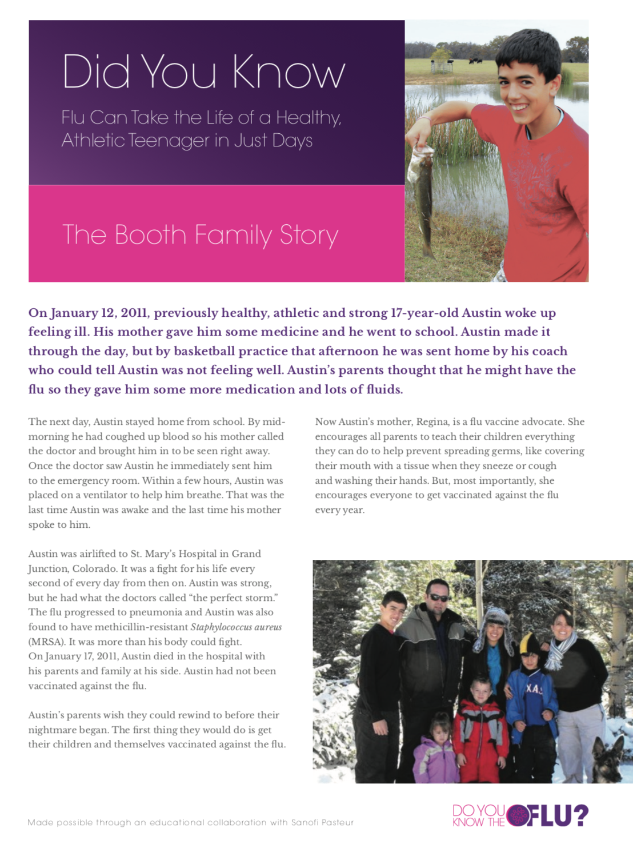
Personal Stories

Slide 24
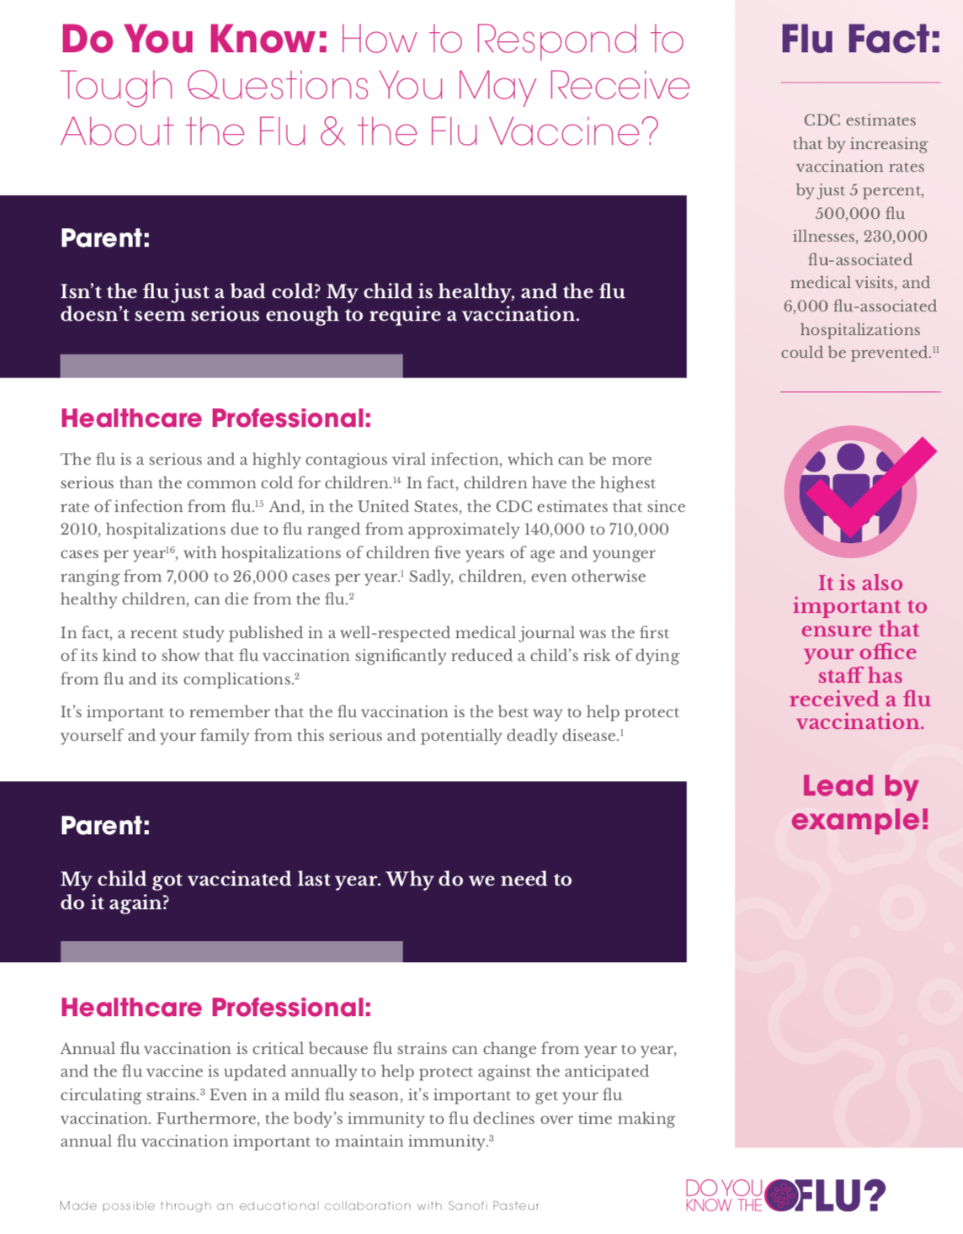
Flu Q&A
Provides a conversation flowchart to assist HCPs with answering important patient questions about flu and flu vaccination

Slide 25
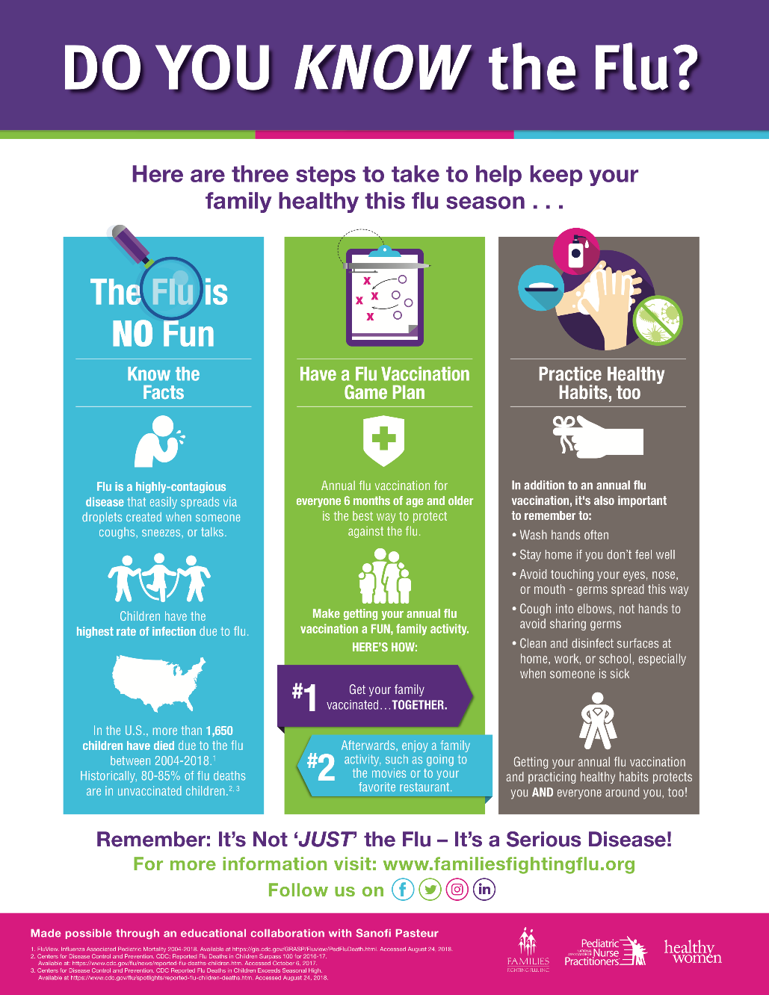
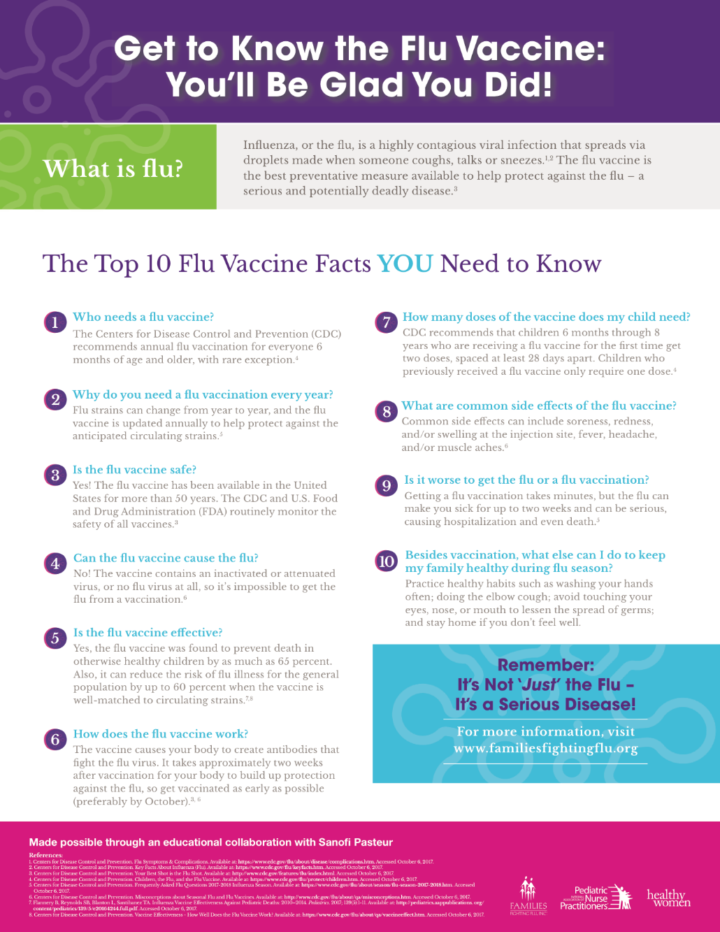
Educational Infographics

Slide 26
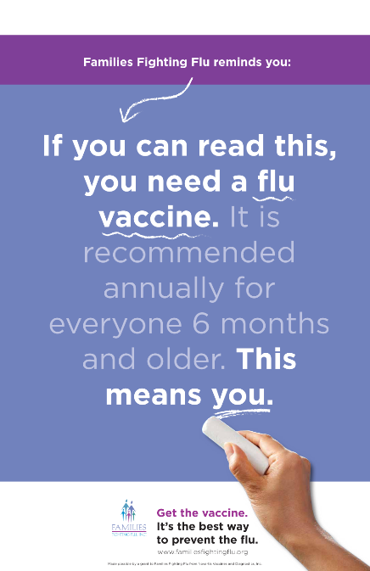
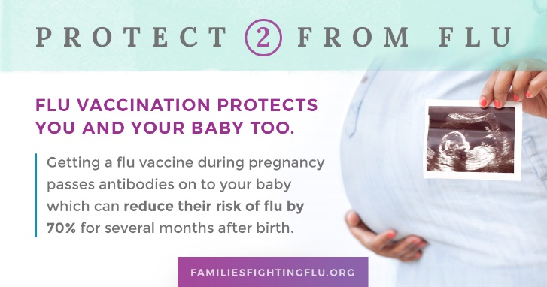
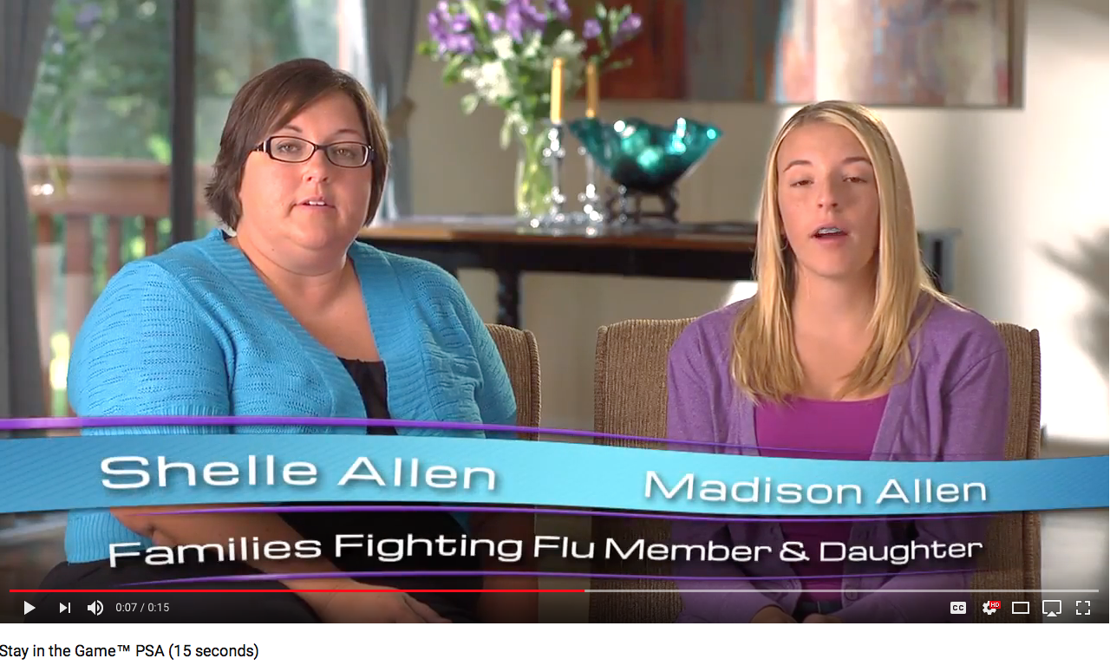
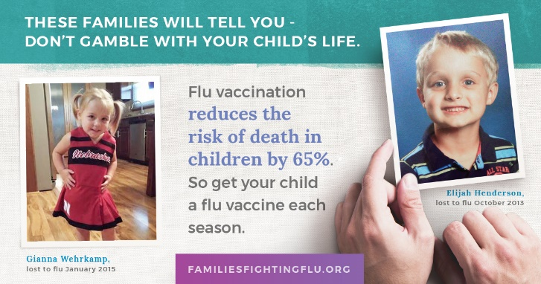
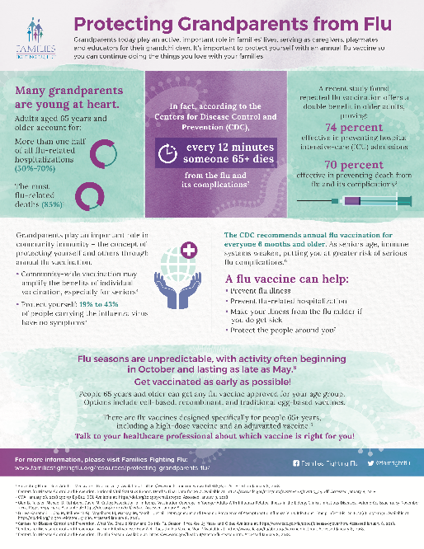
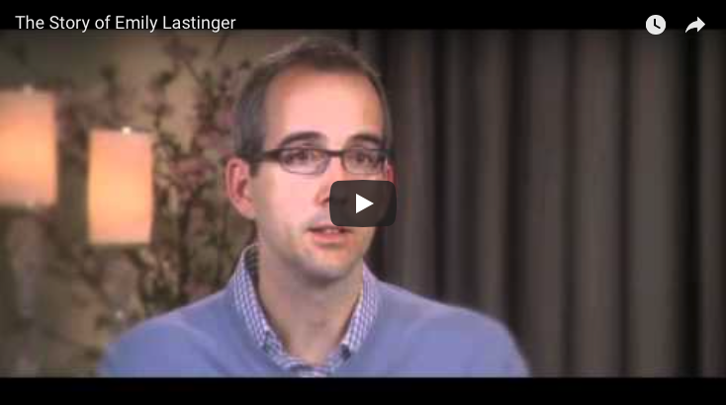
Other FFF Resources
Posters
Social Media Graphics
Public Service Announcements
Infographics
School Worksheets
Family Video Testimonials

Slide 27
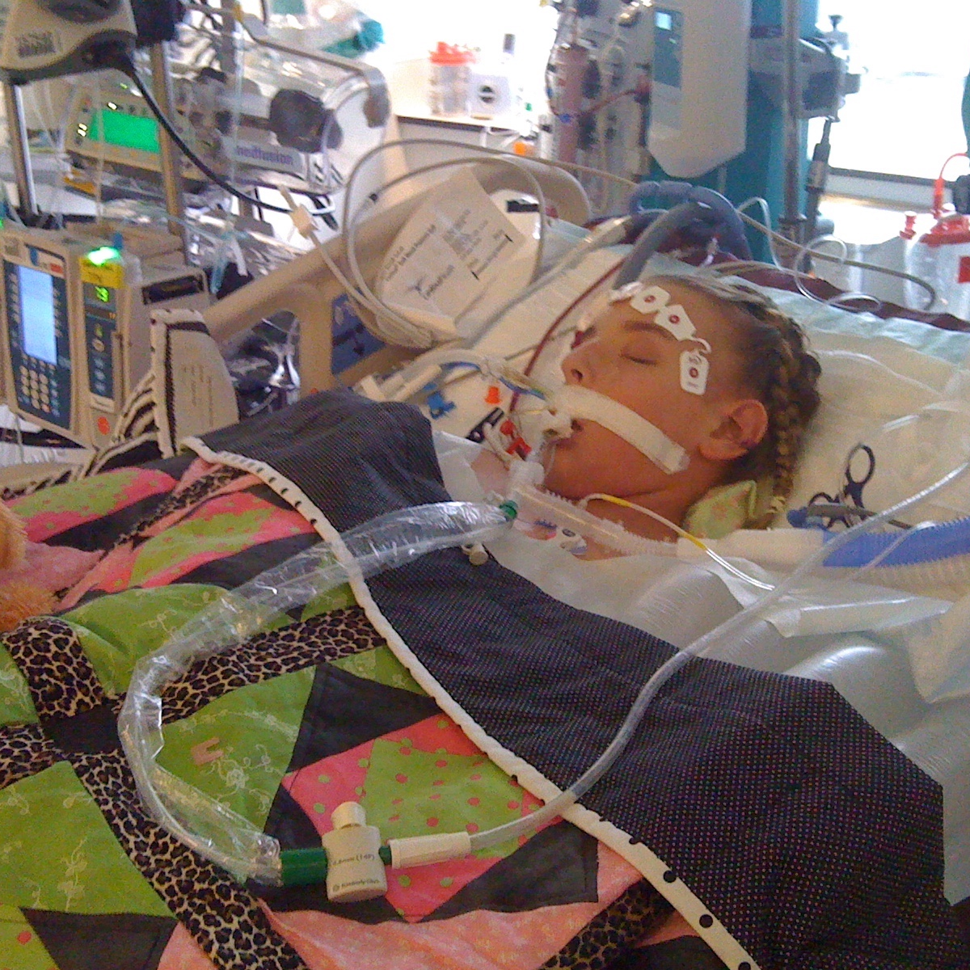
The Power of Personal Stories
Patient Conversations
Social Media
Digital Media
Earned Media
Awareness & education leads to empowerment!
Notes:
To really make an impact on people, you should be including family stories in all education & advocacy efforts!

Slide 28
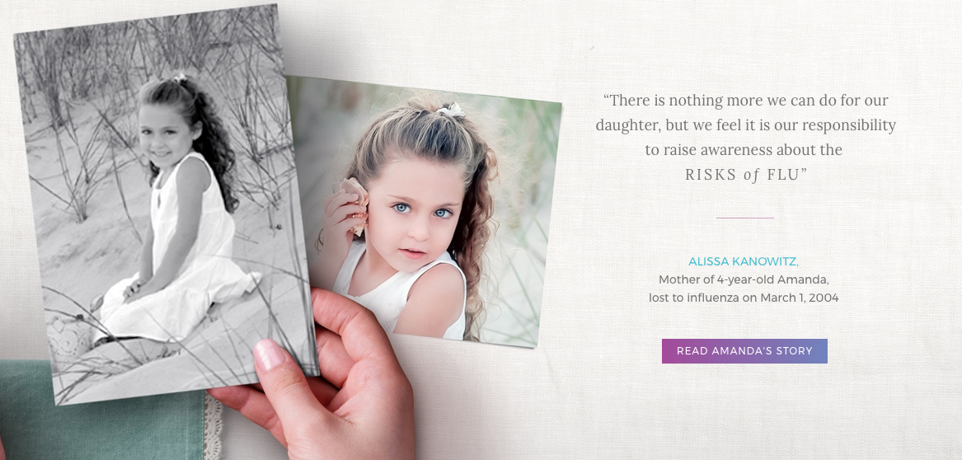
Personal Stories Move People To Action

Slide 29
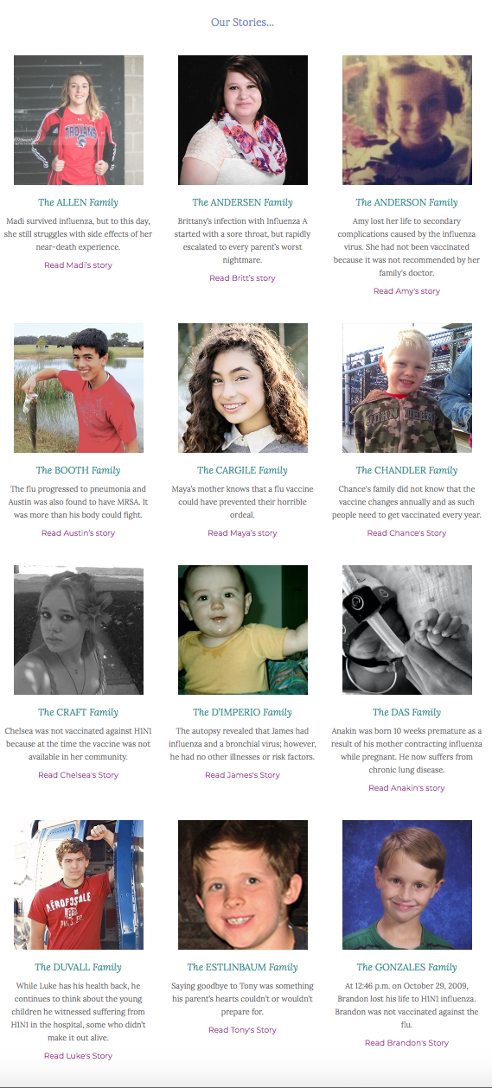
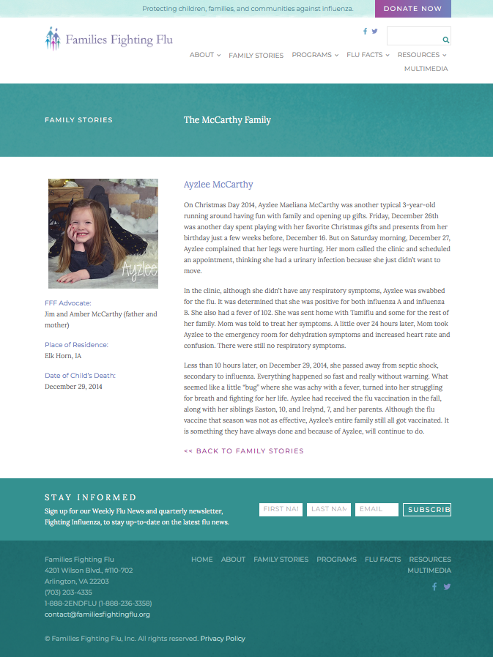
FFF’s Digital Stories
Personal stories make up 50% of FFF’s web traffic!

Slide 30

Social Media As a Critical Channel
69% of People use an average of 3 Platforms
2/3 of
Adults get News
60% of People get Health Information
75% of Parents get Advice
Notes:
Social media may be a good way to reach people in remote areas (rural, frontier populations)!

Slide 31
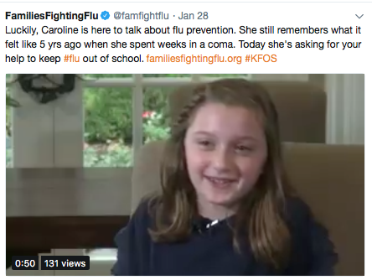
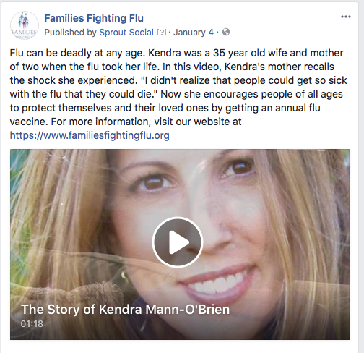
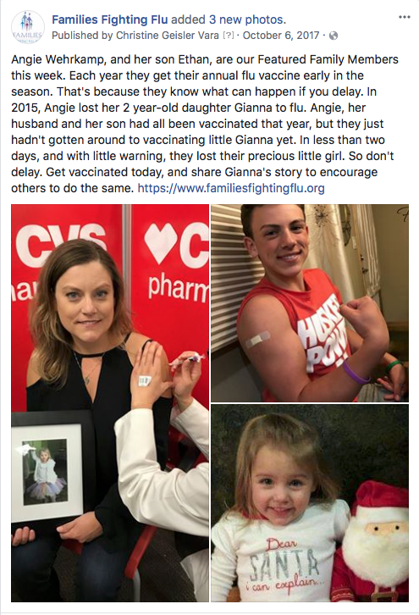
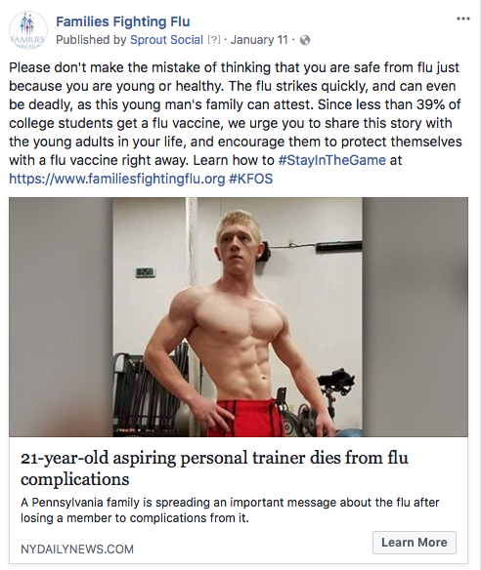
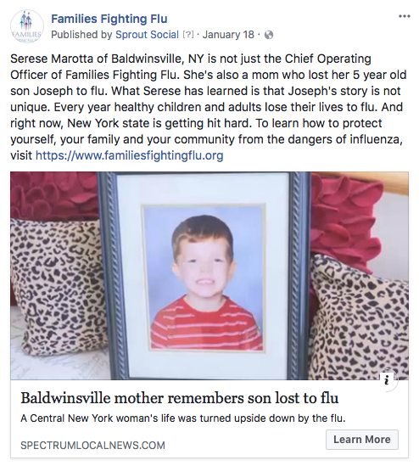
Sharing Personal Stories on Social Media
Personal story engagement on Facebook and Twitter was ~50% and ~35% higher, respectively, compared to all other content!

Slide 32

Call-to-Action
Be a superhero – promote annual flu vaccination!
          Set the example!
Use FFF’s educational resources to educate & inform your audiences!
Share FFF’s flu materials (available for download on website)
Share our key messages
Share our stories (print, videos, PSAs)
Encourage people to share their stories with us
Stay up-to-date on flu news:
Sign up for FFF’s newsletter and Weekly Flu News (through FFF website)
Follow us on social media

Slide 33





Contact Information
Serese Marotta
Chief Operating Officer
(703)203-4335
smarotta@familiesfightingflu.org
Website:
www.familiesfightingflu.org
Social media:
www.facebook.com/familiesfightingflu
www.twitter.com/famfightflu
www.linkedin.com/company/families-fighting-flu
@familiesfightingflu
Notes:
Encourage people to sign up for Weekly Flu News and newsletter!

